Slide 1

INSTITUTE UIE
DEPARTMENT ACADEMIC UNIT-1
Bachelor of Engineering (Computer Science & Engineering)
Subject Name Semi Conductor Physics
Subject Code 23SPH-143
Prepared By
Navjeet Kaur
Lecture-2.1.1
Introduction of BJT Transistor and its Types & Applications
DISCOVER . LEARN . EMPOWER

Slide 2
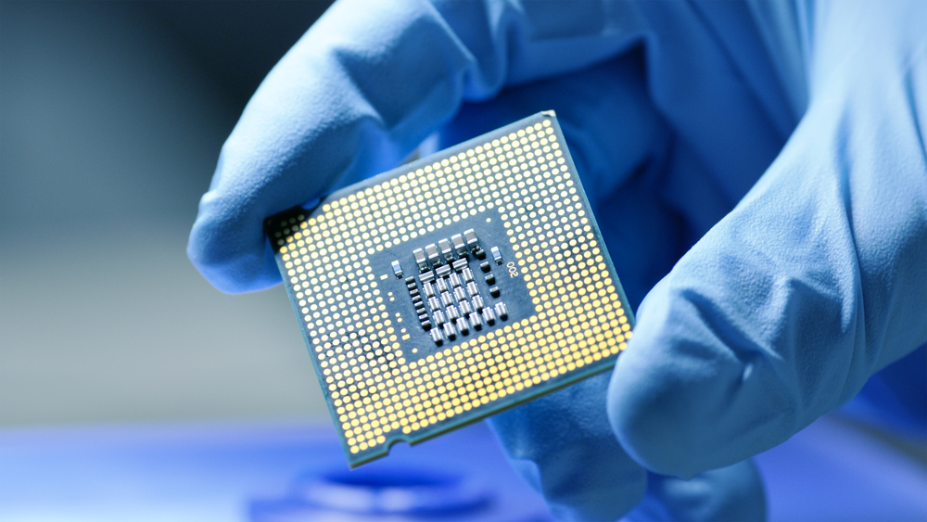
Course Objectives
S. No. | Objectives
1 | To understand the basic materials and properties of semiconductors.
2 | Understand the basic of semiconductor and components like diode, transistor, FET, MOSFET and Energy Sources.
3 | To give knowledge about semiconductor physics and discus working and applications of basic devices, including p-n junctions, BJTs and FETs.
https://www.iqsdirectory.com/resources/everything-you-ever-wanted-to-know-about-semiconductors/

Slide 3
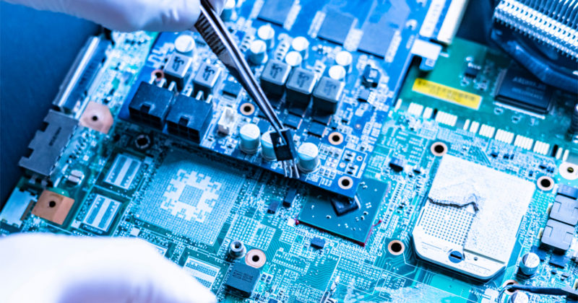
Course Outcomes
S.NO | Description | Blooms’ Taxonomy Level
CO1 | To apply the knowledge of basic semiconductor material physics and understand fabrication processes. | EASY
CO2 | To understand the characteristics of different electronic devices such as diodes, transistors. | MEDIUM
CO3 | To derive the relationships between the parameters in diode, FET, configurations of Transistor and MOSFETs. | MEDIUM
CO4 | To describe the working and design considerations for the various photonic devices like photo detectors, solar-cells and LEDs. | HARD
CO5 | To provide problem solving experience and learning of concepts through it in semiconductor physics. | HARD
https://lot.dhl.com/5-things-the-current-semiconductor-slowdown-tells-us-about-the-global-economy/

Slide 4
What is Electronics
Electronics is the science of how to control electric energy, energy which the electrons have a fundamental role.
Its also deals with electrical circuits that involve active electrical components such as vacuum tubes, transistors, diodes and integrated circuits, and associated passive electrical components and interconnection technologies.
You will work with a number of basic electronic components when building electronic circuits, including resistors, capacitors, diodes, transistors, and integrated circuits. Here is a brief overview of the functions of each of these basic electronic components.
Notes:
Fig-3

Slide 5
Content
n-p-n transistor
p-n-p transistor
Fact about Transistor Terminals
Applications of Transistor
Transistor as an amplifier & Switch

Slide 6
Introduction to Transistor
A transistor consists of two pn junctions formed by *sandwiching either p-type or n-type semiconductor between a pair of opposite types. Accordingly ; there are two types of transistors, namely;
1. n-p-n transistor
2. p-n-p transistor

Slide 7
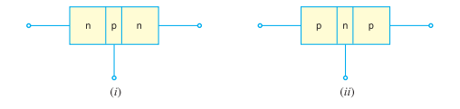
Introduction to Transistor
An n-p-n transistor is composed of two n-type semiconductors separated by a thin section of p-type as shown in Fig. 1.1 (i).
However, a p-n-p transistor is formed by two p-sections separated by a thin section of n-type as shown in Fig. 1.1 (ii).
Figure 1: Formation of n-p-n transistor and p-n-p transistor
(Source: Principles of Electronics, V K Mehta , Rohit Mehta, 12/e , S. Chand Publishing)

Slide 8
Introduction to Transistor
An n-p-n transistor is composed of two n-type semiconductors separated by a thin section of p-type as shown in Fig. 1.1 (i).
However, a p-n-p transistor is formed by two p-sections separated by a thin section of n-type as shown in Fig. 1.1 (ii).
Figure 1: Formation of n-p-n transistor and p-n-p transistor
(Source: Principles of Electronics, V K Mehta , Rohit Mehta, 12/e , S. Chand Publishing)

Slide 9
Introduction to Transistor
In each type of transistor, the following points may be noted:
These are two pn junctions. Therefore, a transistor may be regarded as a combination of two diodes connected back-to-back.
There are three terminals, one taken from each type of semiconductor.
The middle section is a very thin layer. This is the most important factor in the function of a transistor.

Slide 10
Origin of the name “Transistor
A transistor has two pn junctions. One junction is forward biased and the other is reverse biased.
The forward biased junction has a low resistance path whereas a reverse biased junction has a high resistance path.
The weak signal is introduced in the low resistance circuit and output is taken from the high resistance circuit.
Therefore, a transistor transfers a signal from a low resistance to high resistance. The prefix ‘trans’ means the signal transfer property of the device while ‘istor’ classifies it as a solid element in the same general family with resistors.

Slide 11
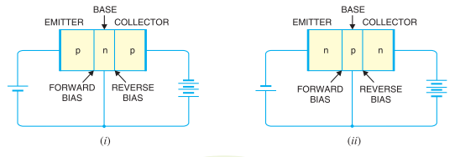
Naming the Transistor Terminals
A transistor (pnp or npn) has three sections of doped semiconductors. The section on one side is the emitter and the section on the opposite side is the collector.
The middle section is called the base and forms two junctions between the emitter and collector.
Figure 2: Sectioning of the transistor
(Source: Principles of Electronics, V K Mehta , Rohit Mehta, 12/e , S. Chand Publishing)

Slide 12
Emitter
The section on one side that supplies charge carriers (electrons or holes) is called the emitter. The emitter is always forward biased w.r.t. base so that it can supply a large number of majority carrier (Holes if emitter is p-type and electrons if the emitter is n-type.).
In Fig. 2 (i), the emitter (p-type) of pnp transistor is forward biased and supplies hole charges to its junction with the base. Similarly, in Fig. 2 (ii), the emitter (n-type) of npn transistor has a forward bias and supplies free electrons to its junction with the base

Slide 13
Collector
The section on the other side that collects the charges is called the collector. The collector is always reverse biased. Its function is to remove charges from its junction with the base. In Fig. 1.2 (i), the collector (p-type) of pnp transistor has a reverse bias and receives hole charges that flow in the output circuit. Similarly, in Fig. 1.2 (ii), the collector (n-type) of npn transistor has reverse bias and receives electrons.

Slide 14
Base
The middle section which forms two pn-junctions between the emitter and collector is called the base. The base-emitter junction is forward biased, allowing low resistance for the emitter circuit. The base-collector junction is reverse biased and provides high resistance in the collector circuit.

Slide 15
Introduction to Transistor
An n-p-n transistor is composed of two n-type semiconductors separated by a thin section of p-type as shown in Fig. 1.1 (i).
However, a p-n-p transistor is formed by two p-sections separated by a thin section of n-type as shown in Fig. 1.1 (ii).
Figure 1: Formation of n-p-n transistor and p-n-p transistor
(Source: Principles of Electronics, V K Mehta , Rohit Mehta, 12/e , S. Chand Publishing)

Slide 16
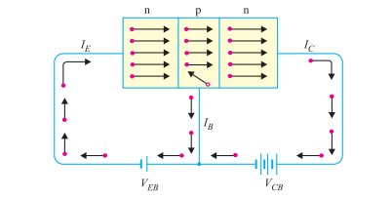
Working of npn transistor
The npn transistor with forward bias to emitter base junction and reverse bias to collector-base junction is shown in Fig. 1.
The forward bias causes the electrons in the n-type emitter to flow towards the base. This constitutes the emitter current IE.
Figure 1: Basic connection of npn transistor
(Source: Principles of Electronics, V K Mehta , Rohit Mehta, 12/e , S. Chand Publishing)

Slide 17
Working of npn transistor
As these electrons flow through the p-type base, they tend to combine with holes. As the base is lightly doped and very thin, therefore, only a few electrons (less than 5%) combine with holes to constitute base current IB.
The remainder (more than 95%) cross over into the collector region to constitute collector current IC. In this way, almost the entire emitter current flows in the collector circuit. It is clear that emitter current is the sum of collector and base currents i.e.
Ie=Ib+Ic

Slide 18
Working of pnp transistor
As the base is lightly doped and very thin, therefore, only a few holes (less than 5%) combine with the electrons. The remainder (more than 95%) cross into the collector region to constitute collector current IC.
In this way, almost the entire emitter current flows in the collector circuit. It may be noted that current conduction within pnp transistor is by holes. However, in the external connecting wires, the current is still by electrons.

Slide 19
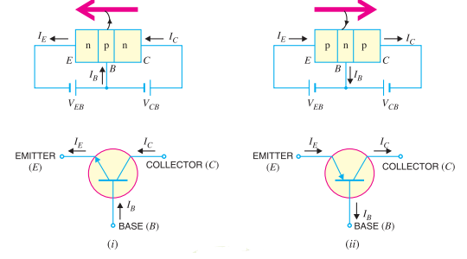
Transistor Symbols
The symbols used for npn and pnp transistors are shown in Figure 3.
Note that emitter is shown by an arrow which indicates the direction of conventional current flow with forward bias.
Figure 3: Symbol of transistor and their current flow
(Source: Principles of Electronics, V K Mehta , Rohit Mehta, 12/e , S. Chand Publishing)

Slide 20
Transistor Symbols
For npn connection, it is clear that conventional current flows out of the emitter as indicated by the outgoing arrow.
Similarly, for pnp connection, the conventional current flows into the emitter as indicated by inward arrow.

Slide 21
Applications of Transistor
Transistor as Switch
Transistor as Amplifier

Slide 22
Summary
Introduction to Transistor.
n-p-n transistor
p-n-p transistor
Transistor Terminal
Doping of the Transistor
Types of Transistor
Applications of Transistor

Slide 23
Frequently Asked Questions
Explain the meaning of transistor.
Explain npn transistor.
Explain pnp transistor.
How is the doping level change in transistor.

Slide 24

LEARNING OUTCOMES
To make students understand
Introduction to Transistor.
n-p-n transistor
p-n-p transistor
Transistor Terminal
Doping of the Transistor

Slide 25
References
Text Books:
Microelectronics Circuits, Adel S. Sedra and Kenneth Carless Smith, Oxford University Press.
Millman’s Integrated Electronics, Jacob Millman, Christos Halkias, Chetan Parikh, McGraw Hill Education.
Digital Logic & Computer Design, M. Morris Mano, Pearson
Reference Books:
Principles of Electronics, V K Mehta , Rohit Mehta, 12/e , S. Chand Publishing
Solid State Electronic Devices,6th Edition, Ben Streetman, Sanjay Banerjee
Electronic Principle, Albert Paul Malvino.
Electronics Circuits:Discrete & Integrated, D Schilling C BeloveTApelewiczRSaccardi.
Microelectronics, Jacob Millman, Arvin Grabel.
Electronics Devices &Circuits,S. Salivahanan, N. Suresh Kumar,A. Vallavaraj
Electronic Devices & Circuit Theory, 11th Edition, Robert L. Boylestad,LouisNashelsky

Slide 26
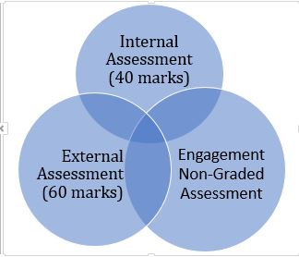
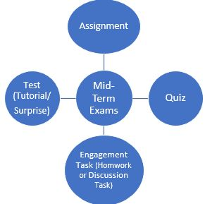
Assessment Pattern

